Slide 1
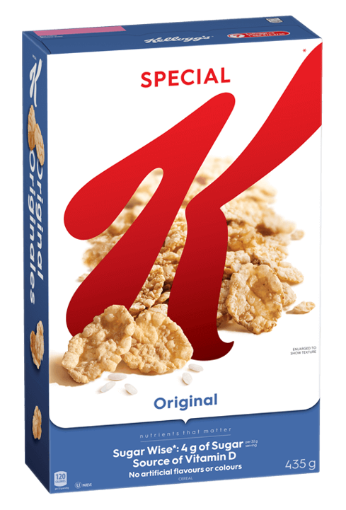
Kellogg Canada SPK Marketing Mix Results 2020-2021 (July 2022)

Slide 2
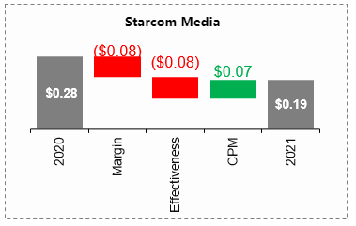
SPK: Key Takeaways
RKSB Total ROI: $0.38 (-$0.08)
Relatively low return may correlate to new brand launch – scaling awareness & size
Profit a key influence on ROI contraction -- if profit/kg held flat to 2020 Total ROI would be flat (@ $0.46)
Brand Building ROI declined (-$0.09) to $0.27 of which Starcom Media ROI declined ($-0.09) to $0.19
Media ROI contraction driven by: Weaker profit and effectiveness (OLV) offsetting CPM improvement (driven by OLV)
ROI decreased for all repeating media tactics – trend would be same at flat profit (excl. Search which would have increased)
Other Brand Building: Several repeating tactics grew ROI (Shelf Media, Shopper Programs)
Flat profit: $0.28 2020 to $0.26 2021

Slide 3
SPK: Key Takeaways
SPK Total ROI: $0.38 (-$0.08)
Relatively low return may correlate to new brand launch – scaling awareness & size
Profit a key influence on ROI contraction -- if profit/kg held flat to 2020 Total ROI would be flat (@ $0.46)
Brand Building ROI declined (-$0.09) to $0.27 of which Starcom Media ROI declined ($-0.09) to $0.19
Media ROI contraction driven by: Weaker profit and effectiveness (OLV) offsetting CPM improvement (driven by OLV)
ROI decreased for all repeating media tactics – trend would be same at flat profit (excl. Search which would have increased)
Other Brand Building: Several repeating tactics grew ROI (Shelf Media, Shopper Programs)
Flat profit: $0.28 2020 to $0.26 2021

Slide 4
SPK: Key Takeaways
Trade ROI declined (-$0.06 to $0.45) - if profit held flat to 2020, trade would have also been flat ($0.52/+$0.01)
2021 investment (excl. production) increased +59% in 2020
Driven by trade (+68%) and brand building (+45%; within which media grew +37%)
Strong consumption growth in Year 2 of Brand launch -- Nielsen measured channel tonnage volume +47%
Driven by trade, distribution, price/kg, and some key marketing tactics to a lesser degree (e.g. OLV, shopper)

Slide 5

Spend & Sales Summary
Notes:
SL 6/24 - AE team, please always draft the 1-2 pager upfront summary (can use Cheez-It version as a template)
- Ritu: Let’s discuss that format/content and if we may want to revise

Slide 6
Overall investment decreased by 16%, driven by -$0.3MM (-22.1%) from Trade. Brand building increased by +$0.1MM (3%) and decreased by media -$0.3MM (-9%)
Trade & Brand-Building Spend ($MM)
20.0
16.8
Starcom Media 2020
$4.0 MM & Retailer Media $0.02 MM
Starcom Media 2021
$3.6 MM & Retailer Media $0.02 MM
Total Brand-Building spend includes all media, Retailer and other spend minus Trade
Brand-Building – TV, Digital Video, Digital Display, Social, Search, OOH, Corporate Promo, Coupon, POS, PR, shelf Media, Sample, Retailer
Production cost included
Notes:
RB 6/23:
AE: Corp Promo spend for 2021 was inaccurate. It has been fixed in the MMM Corp Promo - 2021 and 2020 REV – FINAL file – see tab REV 2021 CORP PROMO. This will impact total 2021 Brand building spend in this slide.
(AE: Updated)

Slide 7
Total investment increased by +2%, driven primarily by (-4.1%) trade. Total media increase driven by media (OLV,Social).
Total Spend Mix - Without Production Cost
Investment ($)
$19,654,416
$16,596,900
-$3,057,516
-16%
Tactics | 2020 ($) | 2021 ($) | Change | % Change | 2020 Share | 2021 Share
Trade | 14,979,870 | 11,882,145 | -3,097,725 | -22.2% | 76.2% | 71.2%
Brand - Building | 4,674,546 | 4,714,755 | 40,209 | 0.9% | 23.8% | 28.8%
Total Media | 3,690,752 | 3,230,765 | -459,987 | -12.5% | 18.8% | 19.7%
Starcom media | 3,653,508 | 3,176,029 | -477,479 | -13.1% | 18.6% | 19.4%
Retail Media | 20,408 | 23,890 | 3,482 | 17.1% | 0.1% | 0.1%
TV | 2,355,515 | 1,912,319 | -443,196 | -18.8% | 12.0% | 11.7%
OLV | 937,162 | 840,531 | -96,631 | -10.3% | 4.8% | 5.1%
OLM | 0 | 71,350 | 71,350 | - | 0.0% | 0.4%
Social | 273,342 | 316,973 | 43,631 | 16.0% | 1.4% | 1.9%
Search | 87,489 | 34,856 | -52,633 | -60.2% | 0.4% | 0.2%
Corp Promo | 94,541 | 142,720 | 48,179 | 51.0% | 0.5% | 0.9%
POS | 16,836 | 30,846 | 14,010 | 83.2% | 0.4% | 0.8%
PR | 100,000 | 170,156 | 70,156 | 70.2% | 2.3% | 4.6%
Coupon | 326,549 | 380,890 | 54,341 | 16.6% | 1.7% | 2.3%
Shelf media | 373,160 | 772,224 | 399,064 | 106.9% | 1.9% | 4.7%
Sampling | 89,544 | 0 | -89,544 | -100.0% | 0.5% | 0.0%
Shopper Program | 0 | 18,000 | 18,000 | - | 0.0% | 0.1%
Total Media includes TV, OLV, Search , Social , OOH , Display,Retailer
Total Brand Building includes Total Media , Shelf Media , POS , PR , Corp Promo , Coupon , Sample, Retailer
Notes:
SL 6/29
2021 Corp Promo s/b $305,858 – pls see REV file per Ritu’s comment below
A/O BTL and Retail Media #s OK
Ritu: Can you please add intel into what drove Trade $ down (you mention later but good to address upfront as it may come up earlier)
(AE: Updated)
RB 6/23:
AE: Corp Promo spend for 2021 was inaccurate. It has been fixed in the MMM Corp Promo - 2021 and 2020 REV – FINAL file – see tab REV 2021 CORP PROMO. This will impact total 2021 Brand building spend in this slide.

Slide 8
With production, total investment increased by -16%. Production costs up by 38% in 2021 driven by TV,OLV and Social
Total Spend Mix – With Production Cost
Investment ($)
$19,932,986
$16,755,065
-$3,177,921
-16%
Tactics | 2020 ($) | 2021 ($) | Change | % Change | Production Cost 2020 | Production Cost 2021
Trade | 14,979,870 | 11,655,310 | -3,324,560 | -22.2% | - | -
Brand - Building | 4,953,116 | 5,099,755 | 146,639 | 3.0% | 278,570 | 385,000
Total Media | 3,,69,322 | 3,615,765 | -353,557 | -8.9% | 278,570 | 385,000
Starcom media | 3,932,078 | 3,561,029 | -371,049 | -9.4% | 278,570 | 385,000
Retail Media | 20,408 | 23,890 | 3,482 | 17.1% | - | -
TV | 2,549,515 | 2,158,319 | -391,196 | -15.3% | 194,000 | 246,000
OLV | 1,015,162 | 930,531 | -84,631 | -8.3% | 78,000 | 90,000
OLM | 0 | 71,350 | 71,350 | - | - | -
Social | 279,912 | 365,973 | 86,061 | 30.7% | 6,570 | 49,000
Search | 87,489 | 34,856 | -52,633 | -60.2% | - | -
Corp Promo | 94,541 | 142,720 | 48,179 | 51.0% | - | -
POS | 16,836 | 30,846 | 14,010 | 83.2% | - | -
PR | 100,000 | 170,156 | 70,156 | 70.2% | - | -
Coupon | 326,549 | 380,890 | 54,341 | 16.6% | - | -
Shelf media | 373,160 | 772,224 | 399,064 | 106.9% | - | -
Sampling | 89,544 | 0 | -89,544 | -100.0% | - | -
Shopper Program | 0 | 18,000 | 18,000 | - | - | -
 |  |  |  | -50% | 278,570 | 385,000
Total Media includes TV, OLV, Search , Social , OOH , OLM, Production, Retailer
Total Media includes TV, OLV, Search , Social , OOH , OLM, Production, Retailer
Total Brand Building includes Total Media , Shelf Media , POS , PR , Corp Promo , Coupon , Sample, Production, Retailer
Notes:
SL 6/27
- 2021 prod’n $s are correct; assume 2020 fine from last year’s inputs
–Ritu: Note I adjusted headline so it’s super clear this version is with production
(AE: Updated)
RB 6/23:
AE: Corp Promo spend for 2021 was inaccurate. It has been fixed in the MMM Corp Promo - 2021 and 2020 REV – FINAL file – see tab REV 2021 CORP PROMO. This will impact total 2021 Brand building spend in this slide.

Slide 9
Volume (scaled up all outlets) decreased -12.6%, driven by decreased support behind Trade and Distribution which outweighed the positive impact from increased media support
SPK Volume Contribution (All Outlets)
Sales Volume
4,267,067
3,730,116
-536,951
-12.6%
Tactics | 2020 | 2021 | Change | % Change | 2020 Share | 2021 Share
Base | 1,834,075 | 1,449,612 | -384,463 | -21.0% | 43.0% | 38.9%
COVID | 176,323 | 35,405 | -140,918 | -79.9% | 4.1% | 0.9%
Trade | 1,829,378 | 1,722,105 | -107,273 | -5.9% | 42.9% | 46.2%
Brand - Building | 603,614 | 558,399 | -45,215 | -7.5% | 14.1% | 15.0%
Total Media | 520,672 | 435,635 | -85,037 | -16.3% | 12.2% | 11.7%
Starcom media | 520,323 | 435,372 | -84,951 | -16.3% | 12.2% | 11.7%
Retail Media | 349 | 263 | -86 | -24.6% | 0.0% | 0.0%
TV | 425,844 | 344,765 | -81,079 | -19.0% | 10.0% | 9.2%
OLV | 77,901 | 42,458 | -35,443 | -45.5% | 1.8% | 1.1%
OLM | 0 | 3,371 | 3,371 | - | 0.0% | 0.1%
Social | 9,852 | 42,011 | 32,159 | 326.4% | 0.2% | 1.1%
Search | 6,726 | 2,766 | -3,960 | -58.9% | 0.2% | 0.1%
Corp Promo | 16,386 | 30,322 | 13,936 | 85.0% | 0.4% | 0.8%
POS | 2,776 | 5,371 | 2,595 | 93.5% | 0.1% | 0.1%
PR | 8,328 | 9,394 | 1,066 | 12.8% | 0.2% | 0.3%
Coupon | 26,719 | 37,576 | 10,857 | 40.6% | 0.6% | 1.0%
Shelf media | 24,746 | 38,003 | 13,257 | 53.6% | 0.6% | 1.0%
Sampling | 3,987 | 0 | -3,987 | -100.0% | 0.1% | 0.0%
Shopper Program | 0 | 2,098 | 2,098 | - | 0.0% | 0.1%
Total Media includes TV, OLV, Search , Social , OOH , Display, Retail,
Total Brand Building includes Total Media , Shelf Media , POS , PR , Corp Promo , Coupon , Sample, Retail
Covid is subset of Base
Base = Total Sales – Trade – Brand-Building; Base factors includes Price, Distribution, competitive impacts, season and others
2020 Nielsen Vs. Non-measured sales ratio 93:07
2021 Nielsen Vs. Non-measured sales ratio 82:10
Notes:
RB 6/23:
AE: Corp Promo spend for 2021 was inaccurate. It has been fixed in the MMM Corp Promo - 2021 and 2020 REV – FINAL file – see tab REV 2021 CORP PROMO.
(AE: Updated)

Slide 10
Significant decrease in Trade spend translated to its lower share in Spends and slightly higher share in Volumes
Cheez-it - Spend vs. Volume Contribution (Nielsen volume scaled up to all outlets)
19.9 MM
16.8 MM
2.4 MM
2.3 MM
+17%
-25%
-9%
-16%
+51%
+48%
-22%
-6%
Spend Share
% Chg 2021
Volume Share
% Chg 2021
Includes production – 2020 - $278K & 2021 - $385K
Notes:
SL 6/8:
This conflicts with previous slides where media spend went up +32% but volume from media is down (from 12% to 10%)?
Pls confirm spend includes production (it should)
Split media into Starcom vs. Retailer
(AE: Updated)
RB: 6/15:
Spend shares don’t match sl 9. e.g. Trade in 2020 was 61.6%, 2021 was 64.98% (AE: Here spend share are including production cost and slide #9 spend share are without production cost)
Volume share does not match sl 11. Eg Trade drove 24.3% of incr vol in 2020, 27.8% in 2021 ( AE: slide#11 incremental volume share are at total level ( Base+ Trade + Brand Building) and here Incremental volumes are just for (Trade + Brand Building)

Slide 11
Growth Drivers

Slide 12
Sales volume reduced by -17.6% driven mainly by TV and distribution -Trade: 6% lower spending in 2021, driven by Trade Lite spend (-10%) - TDP: Driven by Unfrosted Cocoa, Maple & Centres - Raspberry - Media contributed +0.75pt growth driven by TV -Increase in google mobility driven the negative volume in 2021
2021 Vs. 2020 Tonnage Volume Change Due-To’s (Nielsen Volume)
+/- (000’s)
-87 | -4 | -34 | 29 | 3 | 12 | 2 | 0 | 9 | 11 | -4 | 2 | 0 | -158 | -7 | -21 | -174 | -133 | -73
-15.7%
Total Media (-2.3%)
Other Brand Building (0.8%)
Base (24.4%)
+9% GRP | -69% IMP | -27% IMP | +56% IMP | ++ | +51% Spend | +83% Spend | +35207% Spend | +17% Spend | +107% Spend | -- | ++ | -27% IMP | -14% Spend | +2% *** | +4% Avg Price | -13% Avg TDP** | -- | Others*
*Others include a/o factors influencing sales that are not captured explicitly in the model – e.g Brand Equity, Category Trend, Consumer Perceptions, Long Term effects
** Cheez-It Crunch & Original TDP increased in 2021 *** Mondelez Wheat Thins price increased in 2021
Impact of COVID captured through “Google Mobility” & Competition presence during lockdown
Notes:
SL 6/8:
Ritu
TDP +96% -- confirming this aligns with inputs provided (ie won’t be a surprise)? RB: Aligns
Trade spend +68% -- does that align to inputs, and can we see what is driving (Costco/non-measured vs. measured | “Trade Lite”?) RB: Added bullet in slide
TDP: Pls specify which products? My assumption is Yr 2 Innovation likely drove as well as distribution gained from Yr 1 launches
Competition: Which Mondelez products?
Workplaces: What is this?
COVID: Missing as “due to”? We know snacking behaviour was up a lot during COVID so may have had influence year-to-year? (e.g. 2021 maybe a negative if mobility was increasing)
(AE: Updated)

Slide 13
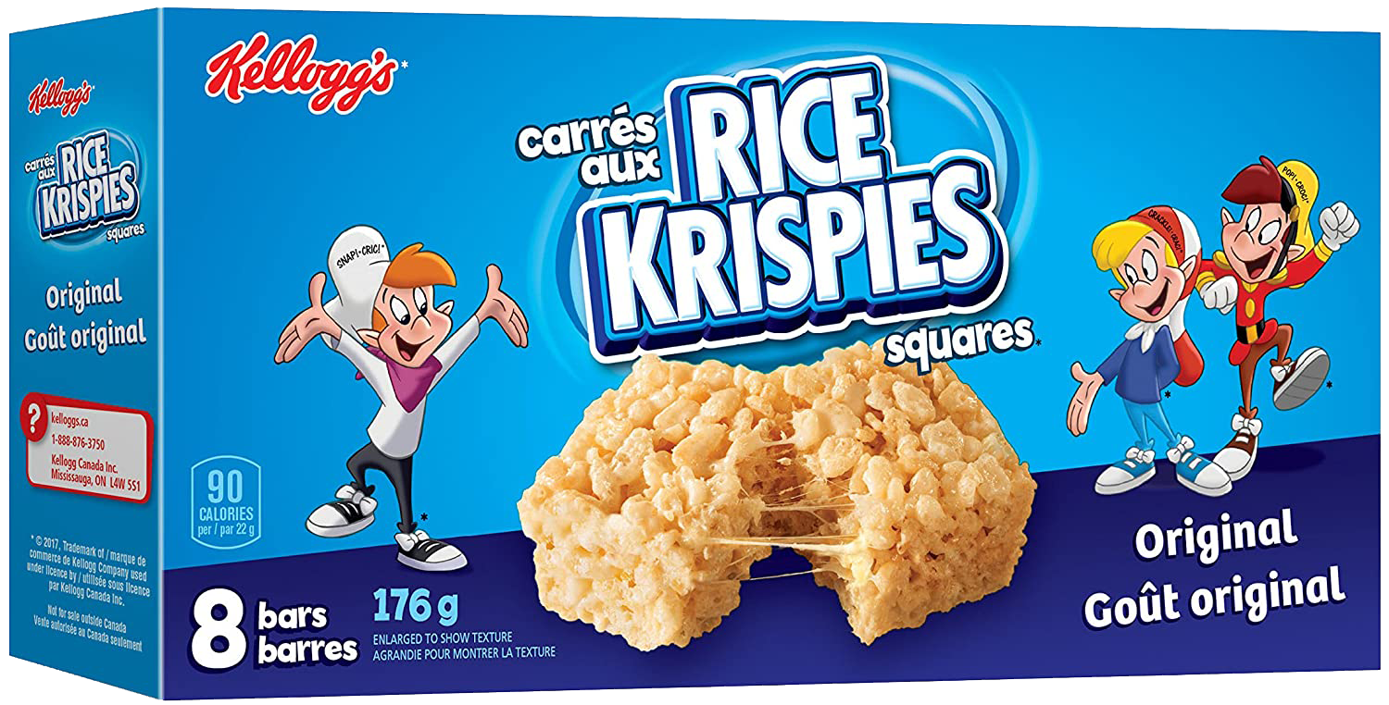
ROI Overview

Slide 14
Slight Increase in total brand ROI driven by increase in Trade and decline by Brand Building (of which Media is a sub-set) – Reduction in 2021 profit is a key contributor to reduced return for brand building $ profit/kg (2021 vs. 2020): Brand Building (-8%) | Trade (+19%)
Profit ROI
(Incremental Volume From Activity x Profit Margin) / Spend Behind Activity
Subset of Brand Building
Subset of Total Media
Spend 000’ $ | Total | Trade | Brand Building | Total Media | Starcom Media | Retail media
2020 | 19,654 | 14,980 | 4,674 | 3,691 | 3,653 | 20
2021 | 16,370 | 11,655 | 4,715 | 3,231 | 3,176 | 24
Note:
Profit Margin Marketing 2020, 2021 = 3.14 $/kg, 3.17 $/kg | Profit Margin Trade 2020, 2021 = 6.50 $/kg, 6.37 $/kg
Total Media includes TV, Digital Video, Digital Display, Social, Search, OOH, production, Retail
Brand-Building includes Total media, Corporate Promo, Coupon, POS, PR, shelf Media & Sponsorship Fees, production, Retail
Notes:
RB 6/23:
AE: The 2020 ROIs do not look right. Using the incr vol and costs from sl 5 & 6 of this deck, BB ROI is 0.80 with PR included.
(AE: Updated )

Slide 15
Flat Profit Scenario: 2021 Brand building and Starcom media ROIs would improve @flat profit though still only flat Vs. 2020
Profit ROI – FLAT PROFIT SCENARIO
(Incremental Volume From Activity x Profit Margin) / Spend Behind Activity
Subset of Brand Building
Subset of Total Media
Spend 000’ $ | Total | Trade | Brand Building | Total Media | Starcom Media | Retail media
2020 | 19,654 | 14,980 | 4,674 | 3,691 | 3,653 | 20
2021 | 16,370 | 11,655 | 4,715 | 3,231 | 3,176 | 24
Note:
Profit Margin Marketing 2020, 2021 = 3.14 $/kg, 3.17 $/kg | Profit Margin Trade 2020, 2021 = 6.50 $/kg, 6.37 $/kg
Total Media includes TV, Digital Video, Digital Display, Social, Search, OOH, production, Retail
Brand-Building includes Total media, Corporate Promo, Coupon, POS, PR, shelf Media & Sponsorship Fees, production, Retail
Notes:
SL 6/27:
Revise headline so more insightful – ie BB and Starcom media ROI would improve @ flat profit though still only flat vs. 2020
(AE : UPDATED)

Slide 16
Brand building: Total media ROI decreased, TV increased slightly but not enough to offset decline in other media tactics, including non-repeat of Search and OOH. Other brand building tactics - POS improved, while other tactics declined; ROIs for POS/Corp Promo/Coupon are close to or above $1
Profit ROI
(Incremental Volume From Activity x Profit Margin) / Spend Behind Activity
Total Media
Other Brand Building
000’ $ | Total Media | Retail Media | Starcom Media | TV | Digital Video | OLM | Social | Search | Corp Promo | POS | PR | Coupon | Shelf media | Sampling | Shopper Program
2020 | 3,691 | 20 | 3,653 | 2,355 | 937 | 0 | 273 | 87 | 94 | 17 | 100 | 326 | 373 | 89 | 0
2021 | 3,231 | 24 | 3,176 | 1,912 | 840 | 71 | 317 | 35 | 143 | 31 | 170 | 381 | 772 | 0 | 18
Media Profit (Benchmark)
Total Media | $0.64
TV | $0.56
OLV | $0.64
OLM/Display | $0.76
OOH | $0.51
Search | $0.73
Social | $0.52
Note:
Profit Margin Marketing 2020, 2021 = 3.14 $/kg, 3.17 $/kg | Profit Margin Trade 2020, 2021 = 6.50 $/kg, 6.37 $/kg
Total Media includes TV, Digital Video, Digital Display, Social, Search, OOH, production, Retail
Brand-Building includes Total media, Corporate Promo, Coupon, POS, PR, shelf Media & Sponsorship Fees, production,Retail
Notes:
SL 6/24:
Ritu: FYI we should steer discussions based on Starcom Media (vs. Total Media, since Retail is a new add and doesn’t have much influence).
Headline: Focus first on media drivers, and then other brand building, e.g
Starcom Media slight contraction – TV increased slightly but not enough to offset decline in a/o media tactics, including non-repeat of Search and OOH
For other brand tactics, POS improved, while a/o tactics declined; ROIs for POS/Corp Promo/Coupon are close to or above $1
Need to revisit commentary once Retail media and Corp Promo are remodelled
(AE: Updated)

Slide 17
Brand building: Total media and Starcom media ROI remains flat with flat profit, only Tv increases and other Starcom media tactics still declines. Other brand building – Corporate promo, Coupon and POS ROIs would improved with flat profit
Profit ROI – FLAT PROFIT SCENARIO
(Incremental Volume From Activity x Profit Margin) / Spend Behind Activity
Total Media
Other Brand Building
000’ $ | Total Media | Retail Media | Starcom Media | TV | Digital Video | OLM | Social | Search | Corp Promo | POS | PR | Coupon | Shelf media | Sampling | Shopper Program
2020 | 3,691 | 20 | 3,653 | 2,355 | 937 | 0 | 273 | 87 | 94 | 17 | 100 | 326 | 373 | 89 | 0
2021 | 3,231 | 24 | 3,176 | 1,912 | 840 | 71 | 317 | 35 | 143 | 31 | 170 | 381 | 772 | 0 | 18
Media Profit (Benchmark)
Total Media | $0.64
TV | $0.56
OLV | $0.64
OLM/Display | $0.76
OOH | $0.51
Search | $0.73
Social | $0.52
Note:
Profit Margin Marketing 2020, 2021 = 3.14 $/kg, 3.17 $/kg | Profit Margin Trade 2020, 2021 = 6.50 $/kg, 6.37 $/kg
Total Media includes TV, Digital Video, Digital Display, Social, Search, OOH, production, Retail
Brand-Building includes Total media, Corporate Promo, Coupon, POS, PR, shelf Media & Sponsorship Fees, production,Retail
Notes:
SL 6/24:
Headline should reflect that – even at flat profit, while Starcom Media becomes flat, still only TV increases, a/o paid media still declines
Need to revisit commentary once Retail media and Corp Promo are remodelled
(AE: Updated)

Slide 18
Media Tactics: ROI Analysis

